Slide 1

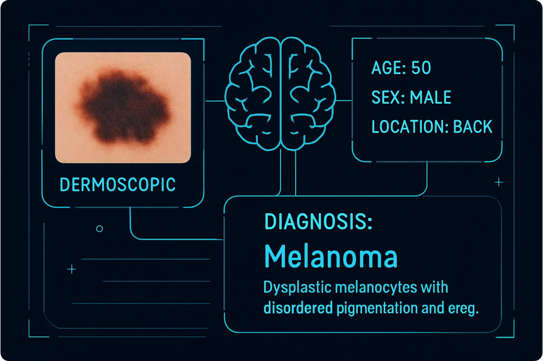
A Multimodal Generative AI System for Skin Lesion Diagnosis and Explanation
Team Members
Aman Chauhan (22BCE0476) • Arnav Sinha (22BCE0830) • Akshat Sinha (22BCE2218)
Mentor: Dr. Naga Priyadarsini R
School: SCOPE Department
Vellore Institute Of Technology, Vellore

Slide 2

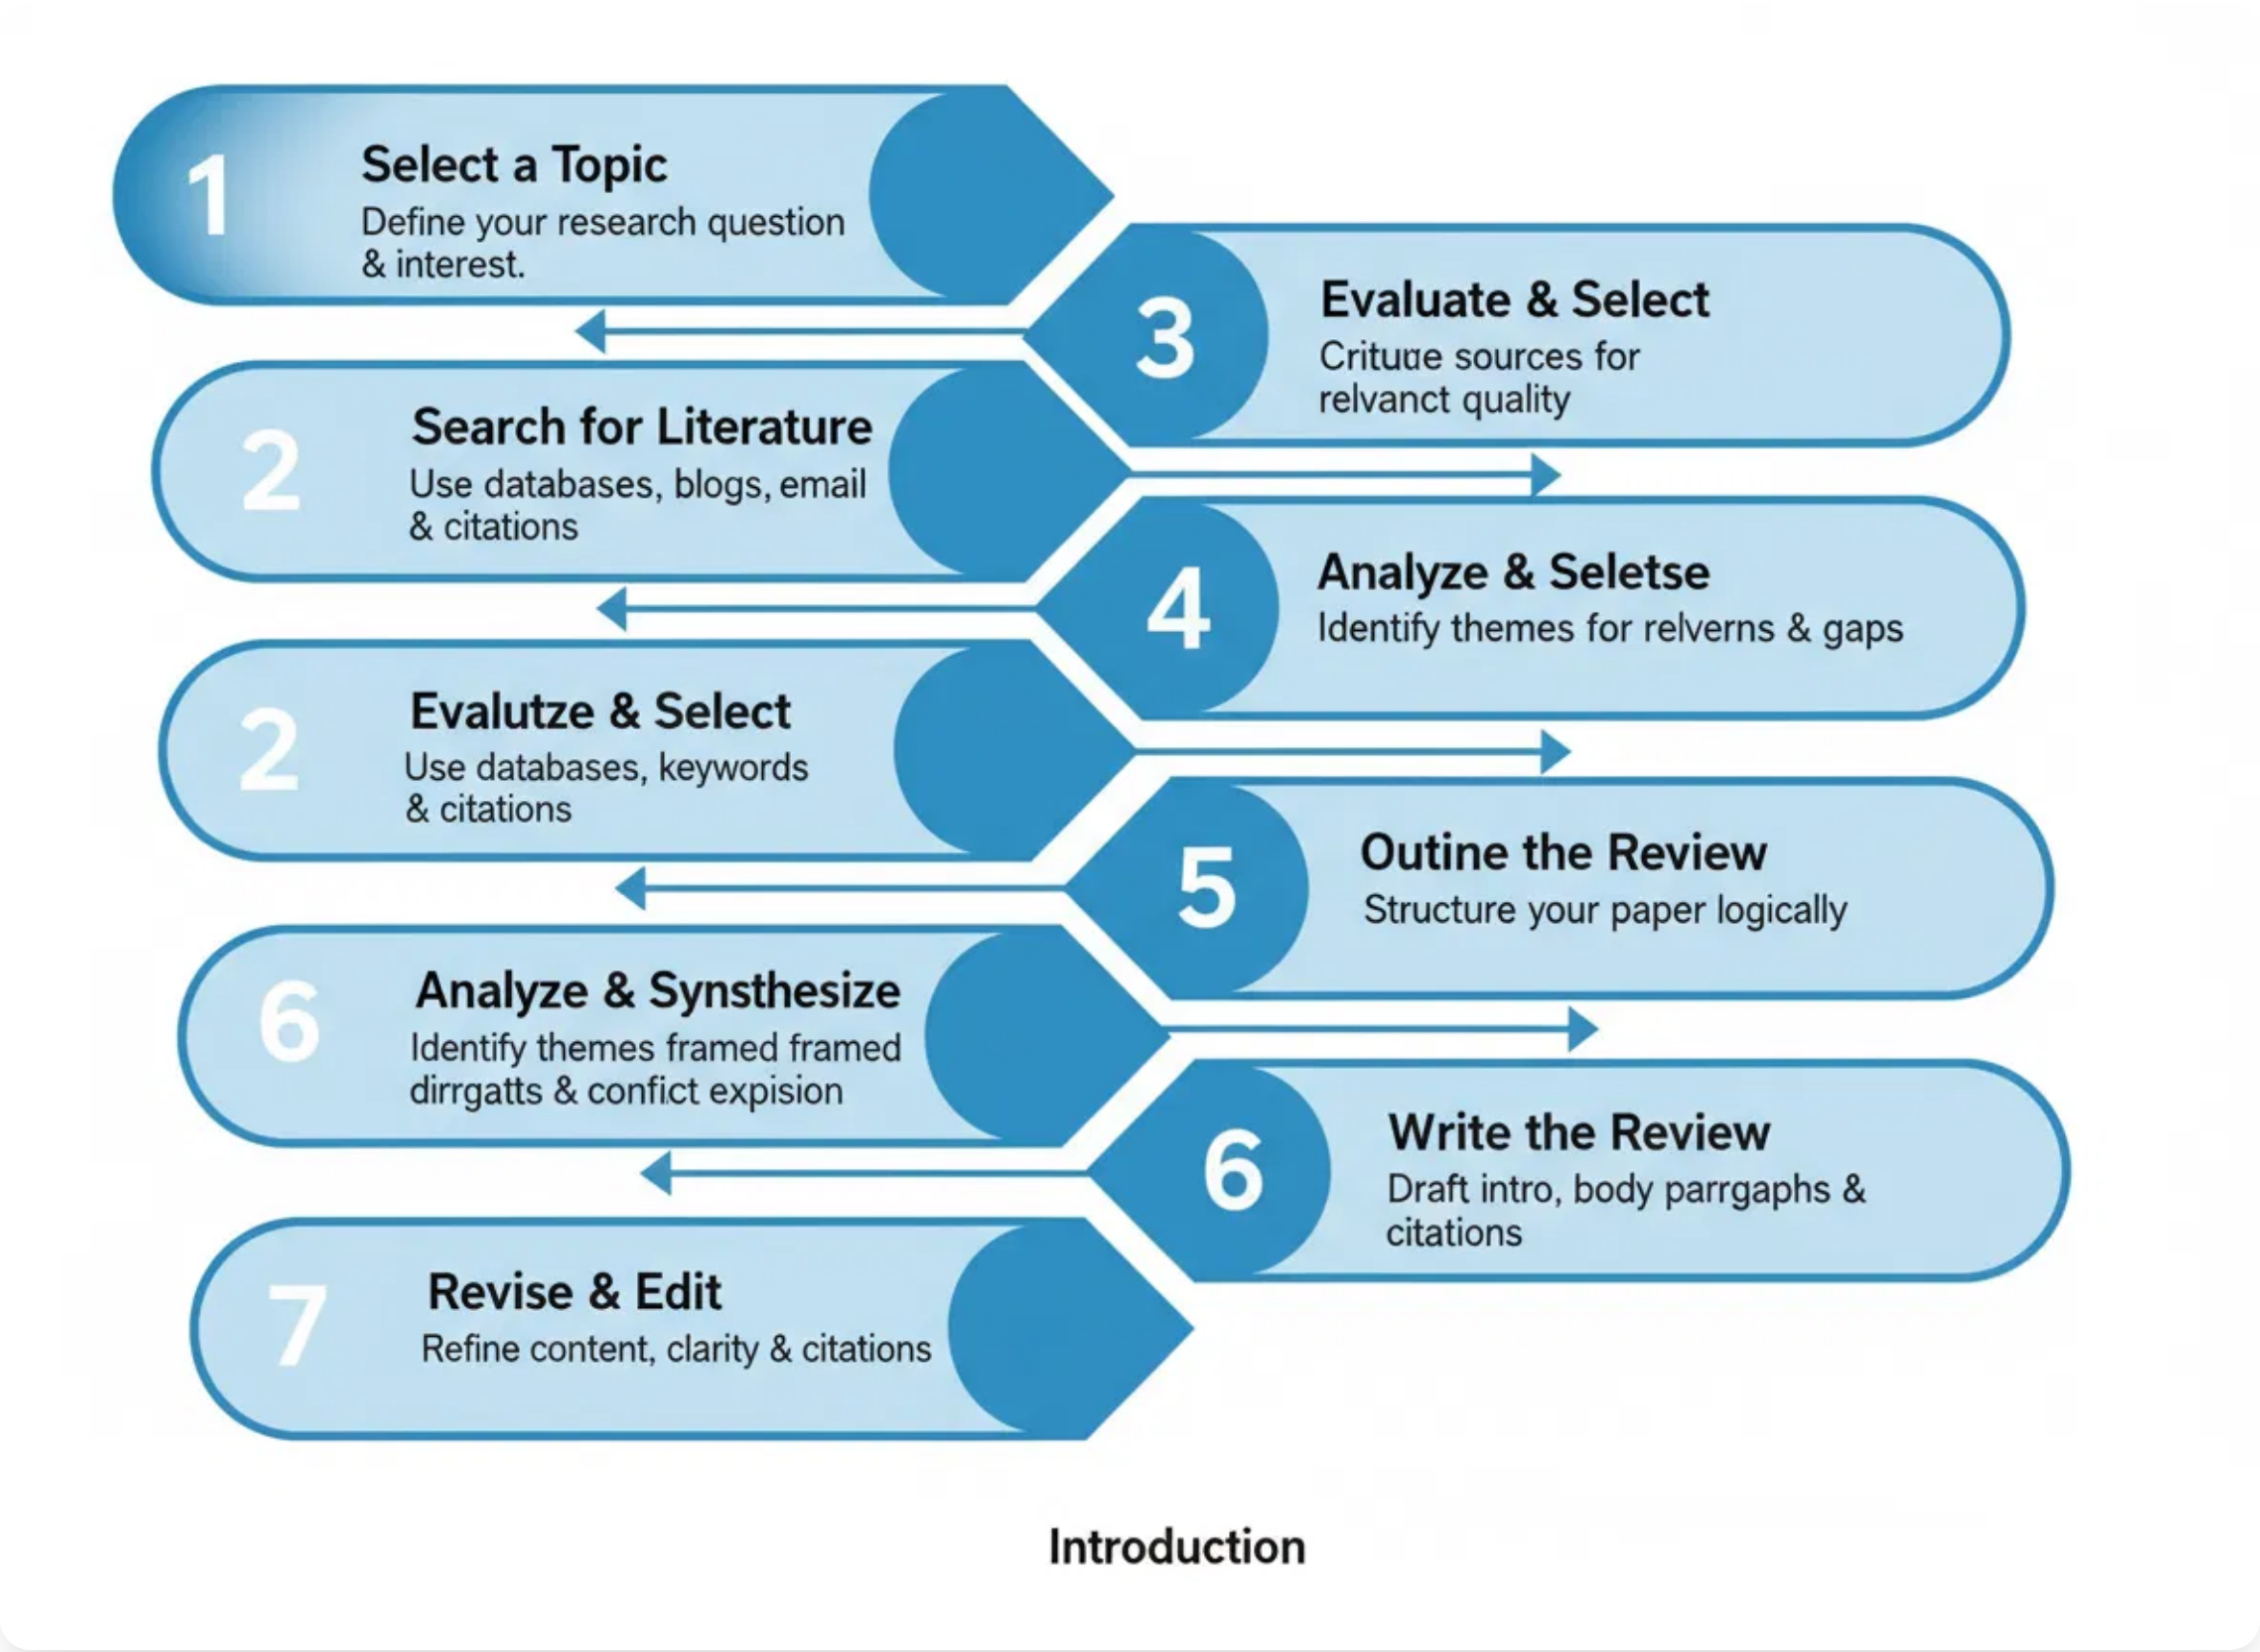
Literature Review
Multimodal AI in Dermatology:
Recent studies show
traditional AI models for skin lesion classification often rely on
single data types, limiting their effectiveness.
Deep Learning Advancements:
CNNs like EfficientNet and
ResNet have shown strong performance in melanoma
detection, while BERT and ClinicalBERT effectively process
clinical metadata.
Fusion Techniques:
Research demonstrates that
concatenation of feature vectors from image and text
encoders improves diagnostic accuracy.
Generative AI Integration:
LLMs like GPT-4 and Llama 3
enable generation of human-readable explanations,
addressing the "black box" nature of traditional AI.
Key Datasets:
The ISIC Archive provides large collections of
dermoscopic images and metadata through various
Systematic approach to literature review in medical AI research
challenges (ISIC 2018, 2019, 2020).
Based on review of 30+ journal papers on multimodal AI and skin lesion diagnosis

Slide 3

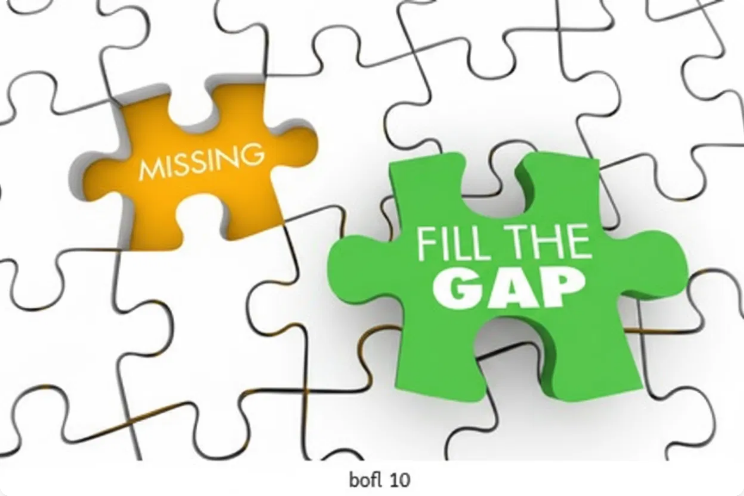
Research Gaps
1. Lack of Explainability in Multimodal AI
Opacity in internal reasoning when fusing visual and textual data
2. Generalizability Across Diverse Datasets
Limited transferability to unseen, real-world clinical data
3. Integration of Generative AI for Reporting
Need for clinically relevant, comprehensive reports beyond simple diagnoses
4. Benchmarking of Fusion Techniques
Lack of systematic comparative studies on multimodal fusion methods
5. Ethical Considerations and Clinical Trust
Addressing bias and building clinician trust in AI-driven diagnostic tools
Identifying and filling critical gaps in skin lesion diagnosis research
6. Real-time Performance Challenges
Optimizing complex models for clinical workflow integration

Slide 4

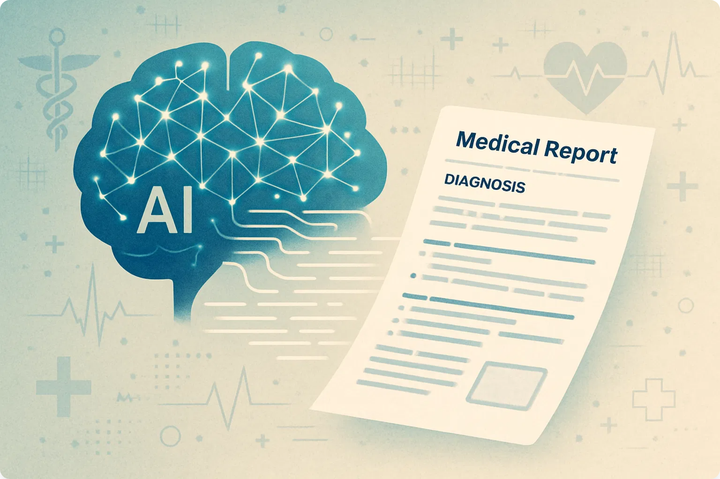
Objectives
1
Develop a Robust Multimodal Diagnostic Model
Create a highly accurate model that fuses visual information from dermoscopic images with textual clinical metadata
2
Generate Intelligent Explanatory Reports
Integrate diagnostic model with LLM to produce clinically relevant, human-readable reports
3
Ensure Accuracy Through Rigorous Validation
Train and validate using ISIC datasets to guarantee high accuracy and generalizability
4
Enhance Diagnostic Accuracy & Clinical Workflow
Provide reliable "second opinion" tool and automate initial analysis and reporting
5
Advance Medical AI
Combine discriminative and generative AI approaches to address the "black box" nature of traditional AI
Generative AI creating comprehensive diagnostic reports

Slide 5









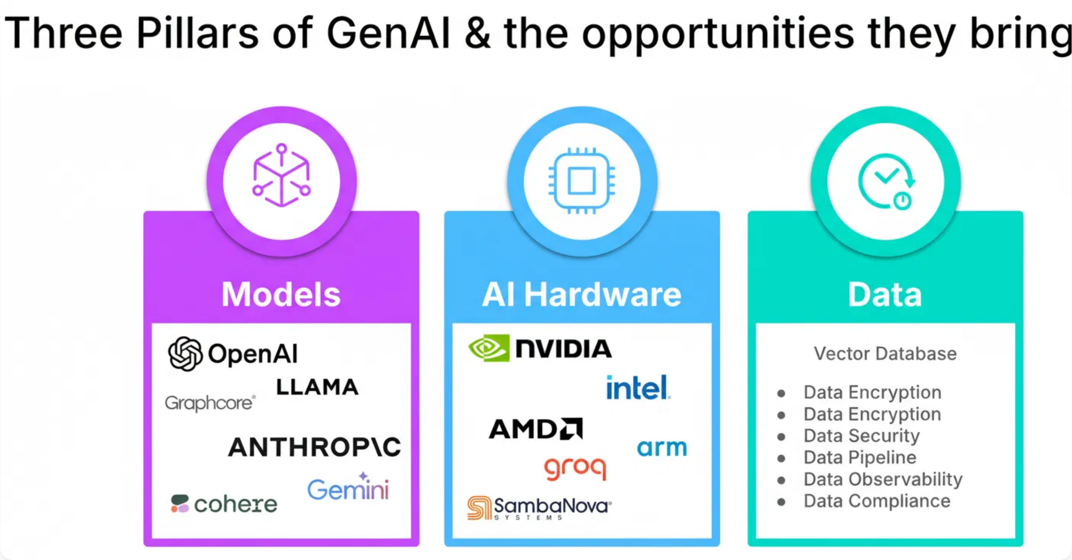
Hardware and Software Specifications
Hardware Requirements
Software Environment
GPU:
NVIDIA A100/V100/RTX series (24GB+ VRAM)
OS:
Ubuntu 20.04 LTS or later
CPU:
Multi-core (Intel Xeon/AMD EPYC)
Language:
Python 3.8+
RAM:
64GB minimum, 128GB recommended
Frameworks:
PyTorch, TensorFlow/Keras
Storage:
1TB+ NVMe SSD
Version Control:
Git, GitHub/GitLab
Three pillars of AI system implementation: Models, Hardware, and Data

Slide 6

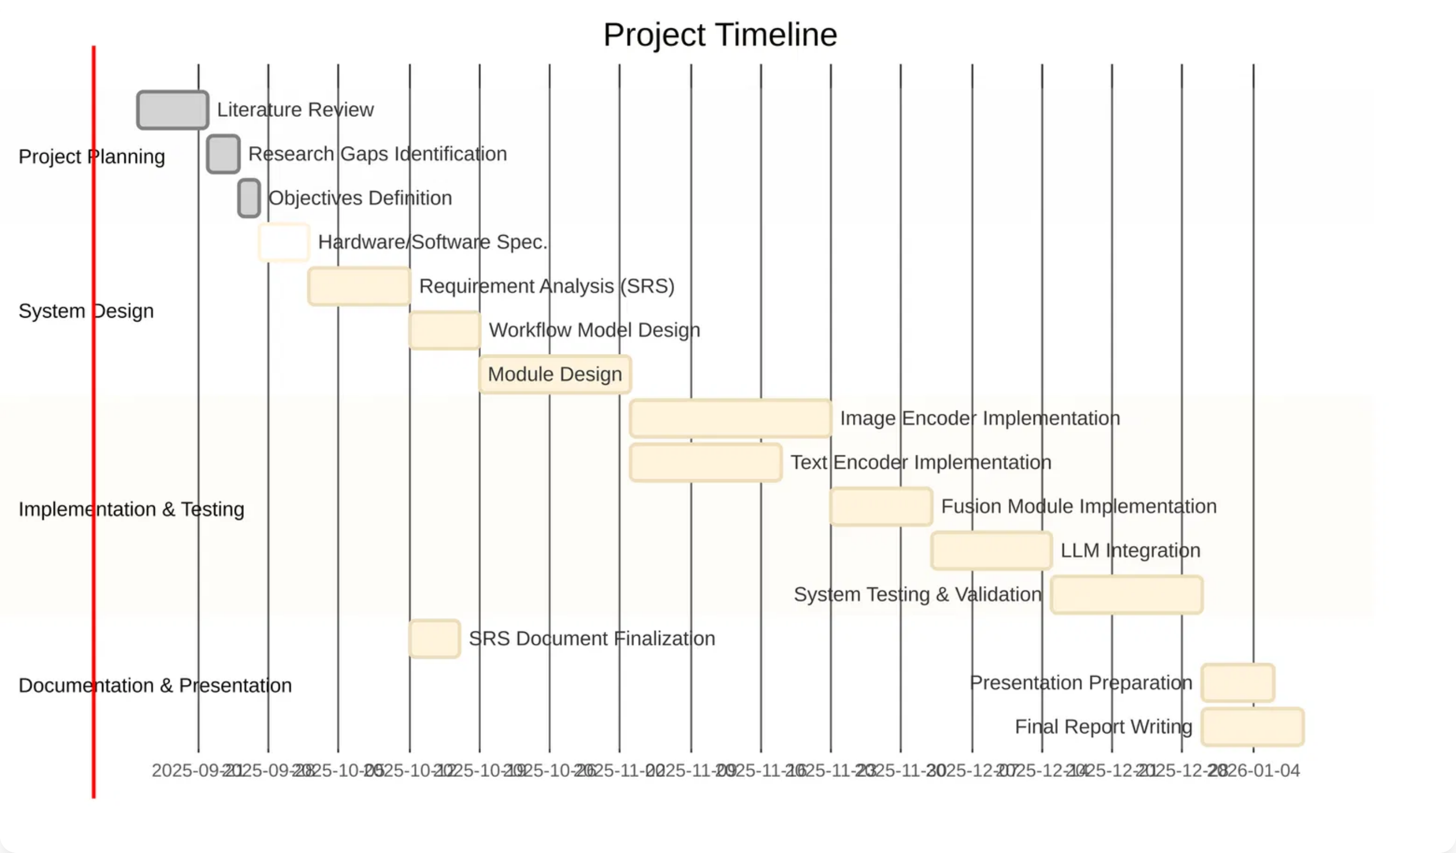
Gantt Chart with Work Breakdown Structure
Project Planning
Implementation & Testing
1
Literature Review (7 days)
6
Image & Text Encoder Implementation (20 days)
2
Research Gaps Identification (3 days)
7
Fusion Module & LLM Integration (22 days)
3
Objectives Definition (2 days)
8
System Testing & Validation (15 days)
System Design
Documentation
4
Hardware/Software Specification (5 days)
9
SRS Document Finalization (5 days)
5
Requirement Analysis (10 days)
10
Final Report & Presentation (10 days)

Slide 7
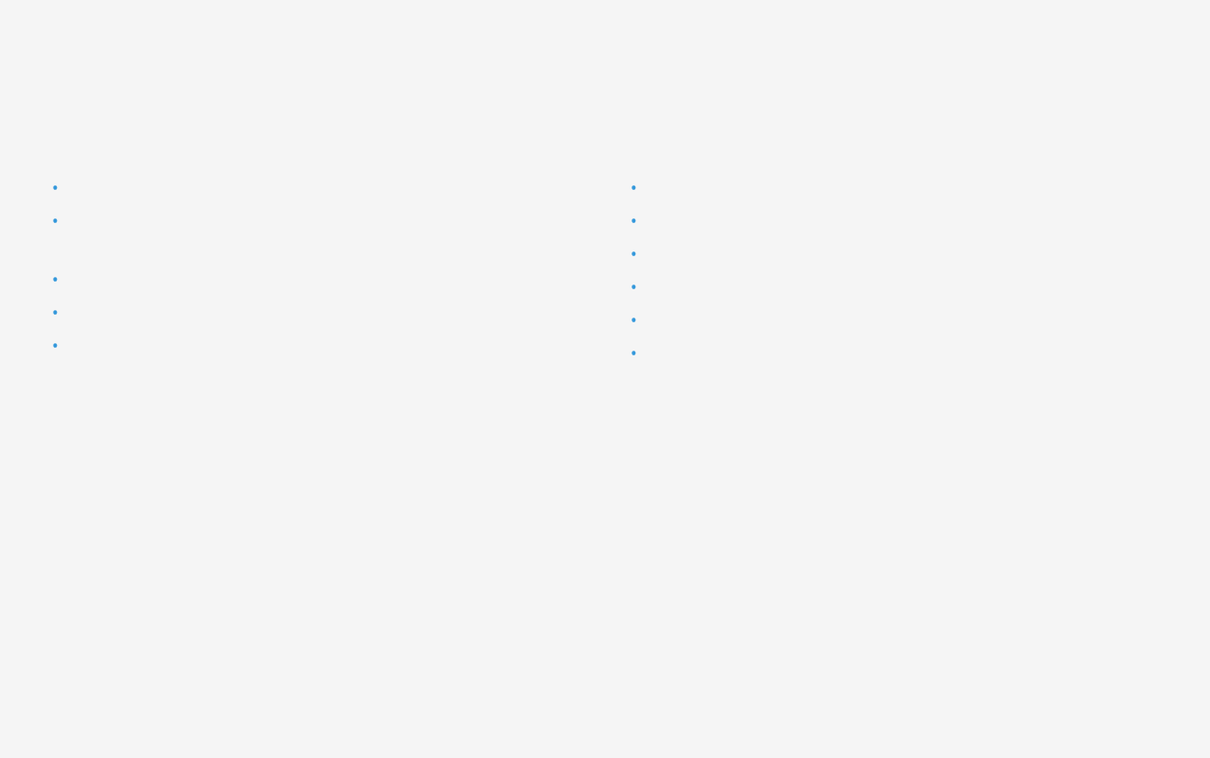

Requirement Analysis (SRS)
Functional Requirements
Non-Functional Requirements
FR1-2:
Accept dermoscopic images and clinical metadata inputs
Performance:
Response time < 10s, 99.9% uptime
FR3-4:
Process images and metadata using pre-trained encoders
Accuracy:
≥ 90% on ISIC datasets
Security:
Data encryption, access control
FR5-6:
Fuse features and classify lesions with confidence scores
Usability:
Intuitive interface for medical professionals
FR7-8:
Generate detailed explanatory reports using LLM
Maintainability:
Modular, well-documented codebase
FR9:
Provide results in structured, consumable formats
Explainability:
Clear, clinically relevant explanations
Systematic analysis of requirements is a critical piece of the research puzzle

Slide 8
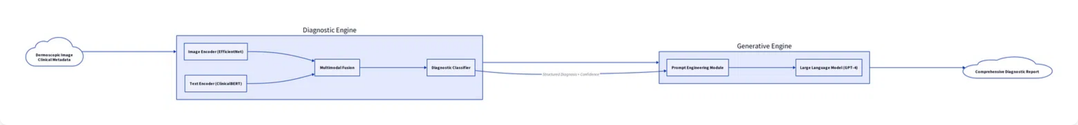
Workflow Model
Diagnostic Engine
Generative Engine
1
Image Encoder (EfficientNet) processes dermoscopic images
5
Prompt Engineering Module creates detailed prompt with diagnosis
2
Text Encoder (ClinicalBERT) processes patient metadata
6
Large Language Model (GPT-4) generates explanatory report
3
Multimodal Fusion combines visual and textual features
7
Final output: Comprehensive diagnostic report with justification
4
Diagnostic Classifier predicts lesion class with confidence

Slide 9
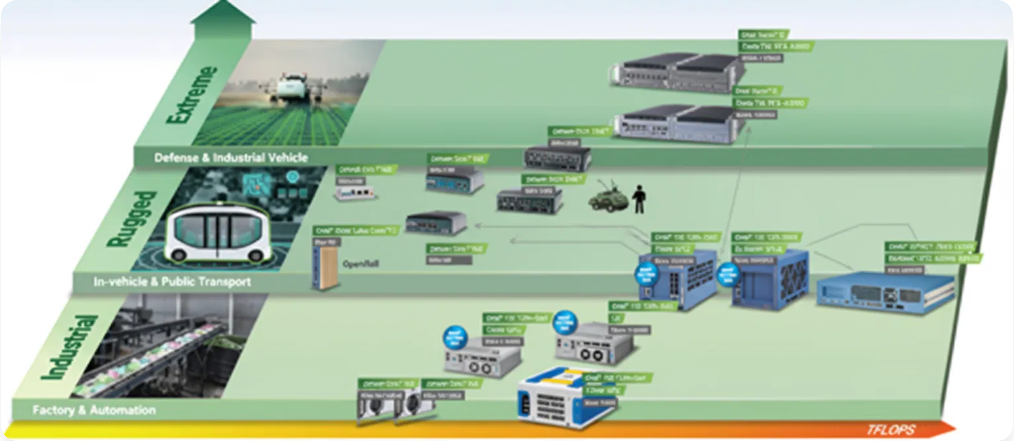
Module Design and Implementation
1
Image Encoder Module
4
Diagnostic Classifier Module
Extracts visual features from dermoscopic images
Predicts skin lesion class probabilities
class ImageEncoder(nn.Module): # Pre-trained EfficientNet
self.classifier = nn.Linear(input_dim, num_classes) # With softmax
2
Text Encoder Module
5
Prompt Engineering Module
Processes clinical metadata using ClinicalBERT
Constructs detailed prompts for the LLM
class TextEncoder(nn.Module): # ClinicalBERT based
def generate_prompt(self, diagnosis, confidence, patient_info):
3
Multimodal Fusion Module
6
LLM Integration Module
Combines visual and textual features
Generates the final diagnostic report
def forward(self, image_features, text_features): # Concatenation
def generate_report(self, prompt): # Using LLM (GPT-4/Llama 3)
Modular system architecture enables independent development and testing

